Slide 1
Developing Integration Solutions using Microsoft BizTalk Server 2013
Day 1 Key Learnings

Slide 2





BizTalk Architecture
Host
Host
Receive Port
Send Port
Receive Location
Adapter
Host
Adapter
Orchestration
Pipeline
Pipeline
Map
Map
Message Box
Messages
Subscriptions

Slide 3
Receive Ports and Receive Locations
Host
Receive Port
Message Exchange Patterns (MEP)
Receive Location
Adapter
One-Way – Receives messages Polling ports are also One-Way.
Two-Way – Receive/Response Receives message and sends back a response message
Pipeline
Receive Port settings
Location(s)
Maps
Tracking options
Map

Slide 4
Receive Ports and Receive Locations
Host
Receive Port
Receive Location settings
Receive Location
Adapter
Transport
Receive Handler (Host)
Pipeline(s)
Service (Operation) Window
Pipeline
Receive Location Status
Map
Enabled
Disabled

Slide 5
Send Ports
Message Exchange Patterns (MEP)
Host
Send Port
One-Way – Sends messages
Two-Way – Solicit/Response Sends message and waits to receive a response
Adapter
Pipeline
Send Port Status
Map
Unenlisted / Bound
Stopped / Enlisted
Started

Slide 6
Send Ports
Send Port settings
Host
Send Port
Primary and Backup Transport
Retry options
Send Handler
Pipeline(s)
Filters
Service (Operation) Window
Maps
Tracking options
Adapter
Pipeline
Map

Slide 7

Send Port Groups
Send Port Group
Send Port
Adapter
Pipeline
Map
Tips!
Use a Send Port Group if you want to specify a filter for a more then one Send Port.
Send Port
Adapter
Pipeline
Map

Slide 8
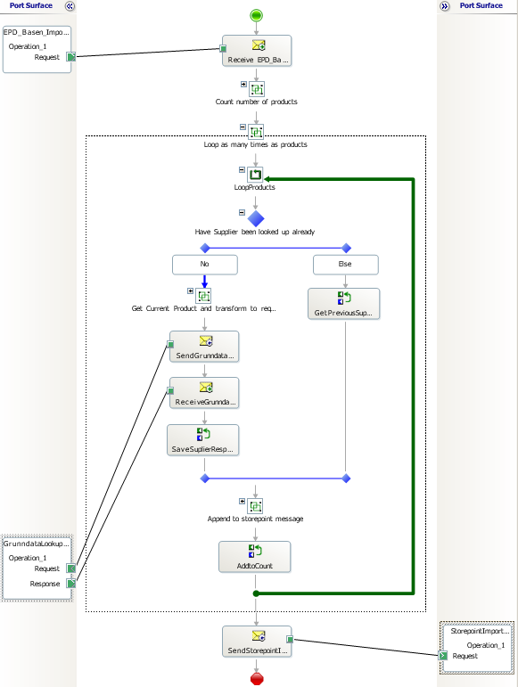

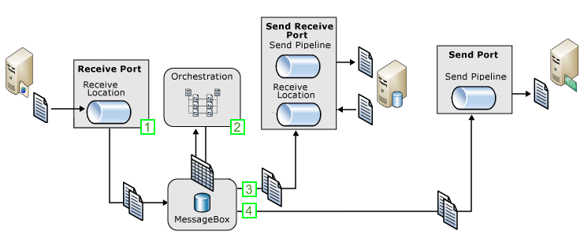
Typical Message flow scenario
Receive order, lookup data, send to subscriber
Receive message through a receive port.
An orchestration subscribes to the message to perform processing and enrichment.
As part of the processing messages are sent to a solicit-response send port (Web service) to lookup data
The message is enriched (mapped), to contain the sum of all parts.
When processing is completed the message is sent to the final recipient through a send port.

Slide 9
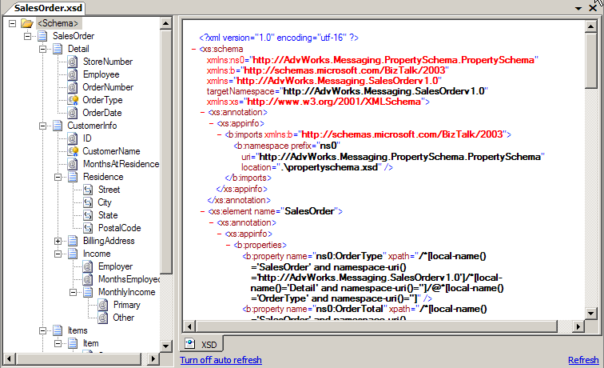
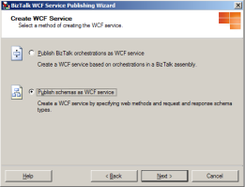
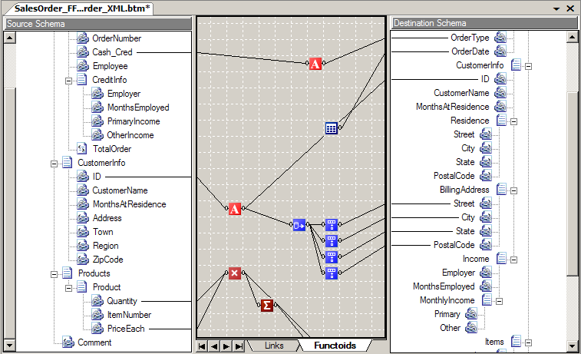


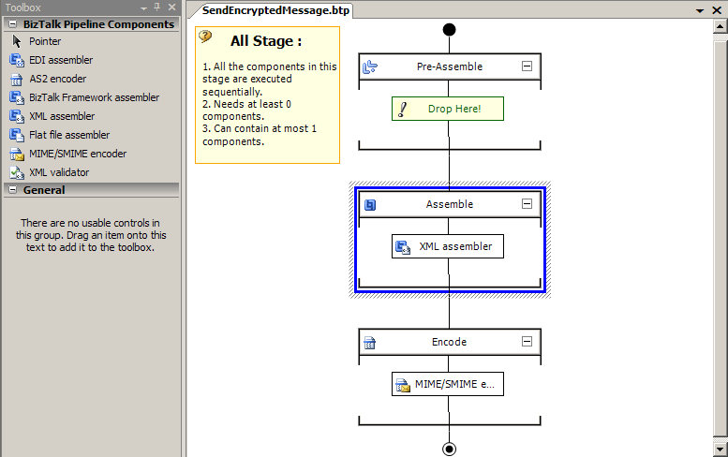
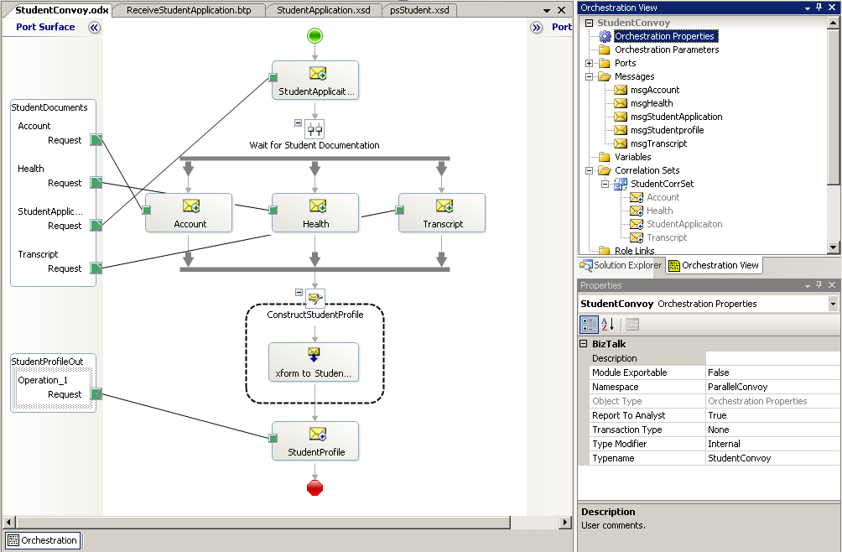
Define Schemas
Rapid development
Transform Data
Wizards
BizTalk Mapper
BizTalk Editor
Design Business Processes
Process Messages
Orchestration Designer
Pipeline Designer
BizTalk Server 2006 – Visual Studio 2005
BizTalk Server 2009 – Visual Studio 2008

Slide 10
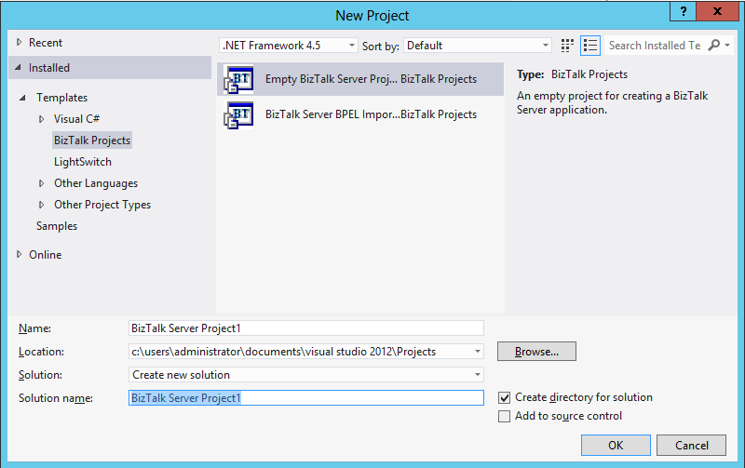


Project Templates
BT
BT
Empty BizTalk Server Project
BizTalk Server BPEL Import

Slide 11
What Is a BizTalk XML Schema?
<xs:schema xmlns="http://bLogical.RssFeed"
targetNamespace="http://bLogical.RssFeed"
xmlns:xs="http://www.w3.org/2001/XMLSchema">
<xs:element name="RssFeed">
<xs:complexType>
<xs:sequence>
<xs:element name="Title" type="xs:string" />
<xs:element name="Link" type="xs:string" />
<xs:element name="Author" type="xs:string" />
<xs:element name="PubDate" type="xs:dateTime" />
<xs:element name="Description" type="xs:string" />
</xs:sequence>
</xs:complexType>
</xs:element>
</xs:schema>
BizTalk uses the XML schema definition language (XSD)
XML schemas define the data structure for all XML business documents
BizTalk requires schema definitions to be deployed in order to recognize the Messge Type.
Attribute
Element
<Invoice>
<Customer ID="1234">
<Name>Kramerica Industries</Name>
...
</Customer>
<InvoiceRows>
<InvoiceRow>
...
</InvoiceRow>
</InvoiceRows>
</Invoice>
Elements
<ns0:RssFeed xmlns:ns0="http://bLogical.RssFeed">
<Title>BizTalk Rocks!</Title>
<Link>http://bLogical.se/blogs/wmmihaa/biztalk_rocks.aspx</Link>
<Author>Mikael Håkansson</Author>
<PubDate>2010-05-31T13:20:00.000-05:00</PubDate>
<Description>bla bla bla</Description>
</ns0:RssFeed>

Slide 12
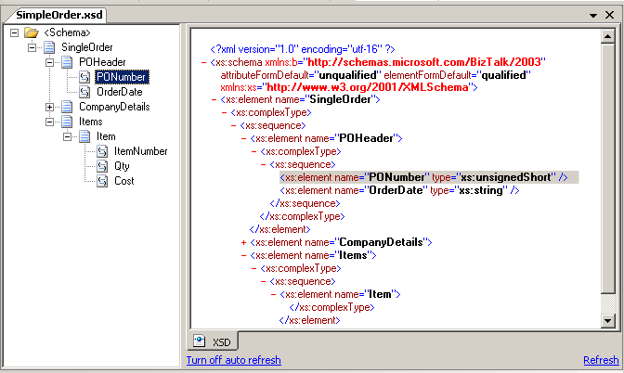
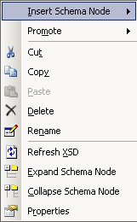
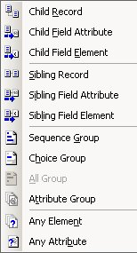
Schemas and the Schema Editor
Schemas represent the message data structure
Data is XML, delimited or positional
Schema Tree View
Editor options
XSD View

Slide 13
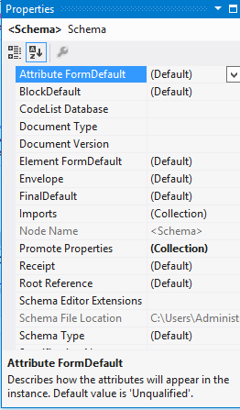
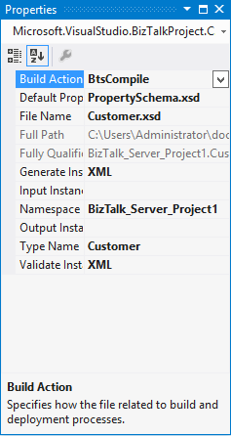
Schema properties
Schema node properties
File & Input/output properties

Slide 14
Maps and the Mapper
Functoid
BizTalk maps are used for data transformation and translation
They are based on XSLT
Source
Schema
Map Grid
Destination Schema

Slide 15
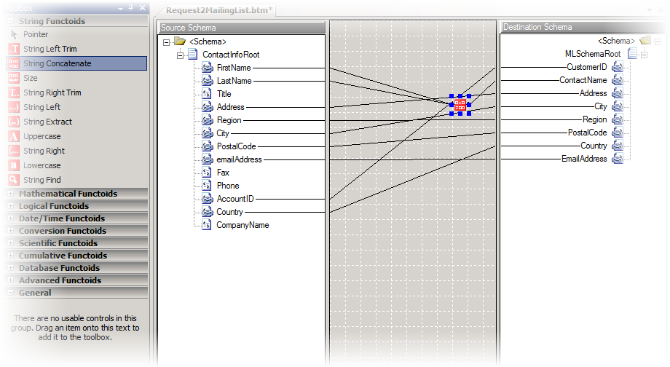
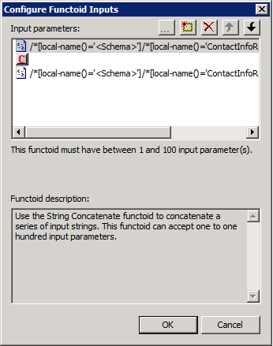
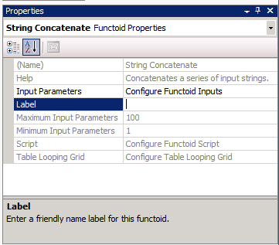
Adding Functoids to a Map
Grid
Functiod
Configuration
Toolbox

Slide 16
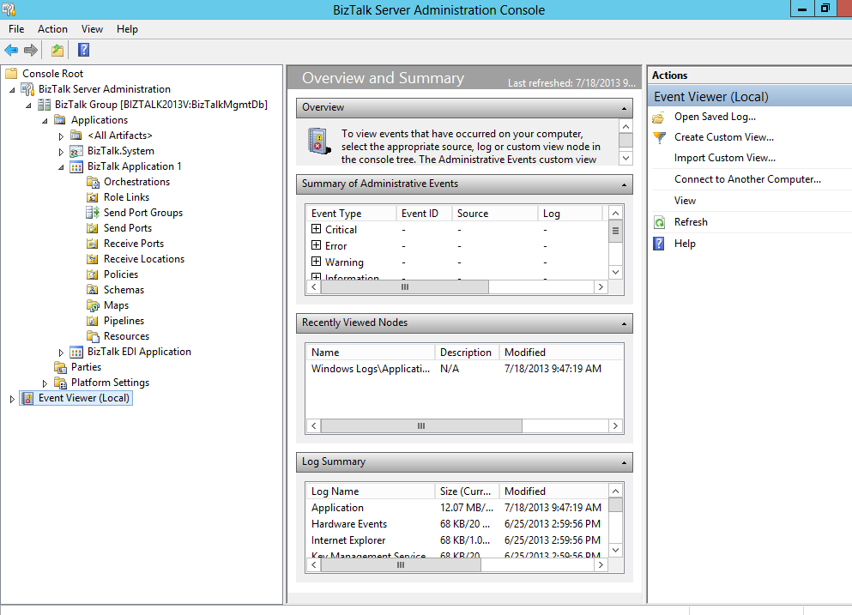
Administration Console
Configuration and Management
Applications
Ports, Adapters, Pipelines
Orchestrations
Start, Stop
Import, Export
Troubleshoot
MMC Console

